Slide 1
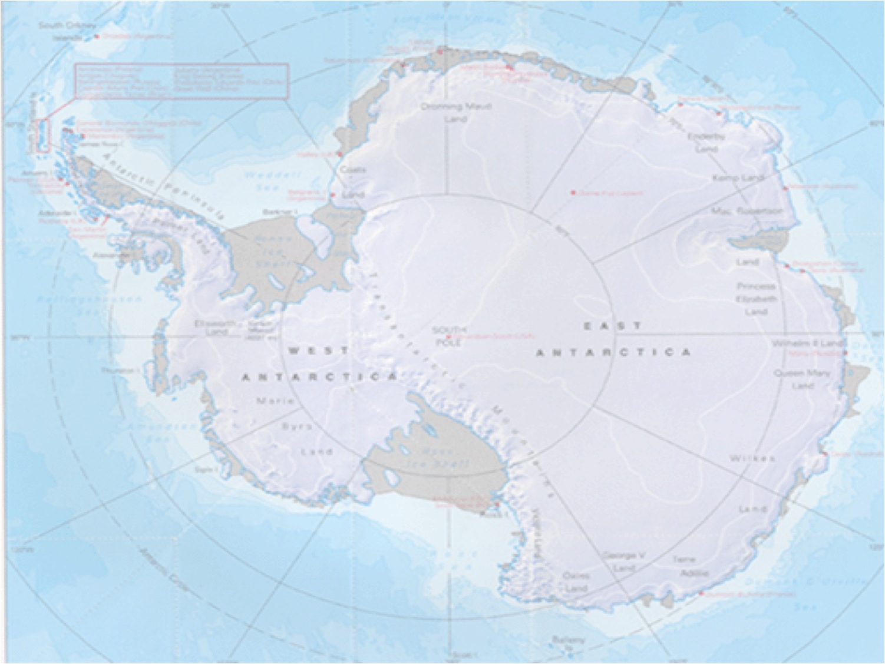
Simulating the evolution of the Antarctic ice sheet using the SIA
Pierre Dutrieux
Sue Cook
Ward van Pelt

Slide 2
The Shallow Ice Approximation (SIA)
Thickness evolution:
Diffusivity:
“Shallow” ice sheet: L>>H
Non-sliding ice flow diffuses the shape of the ice sheet

Slide 3
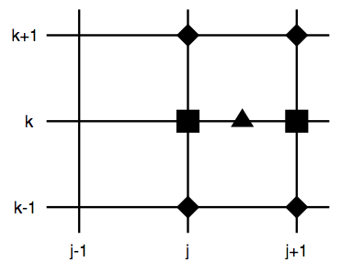
Numerical properties
Explicit scheme
  Advantage: H determined by quantities known at the previous time-step
Time-step determined by stability criterion:
Staggered grid (Mahaffy, 1976)

Slide 4
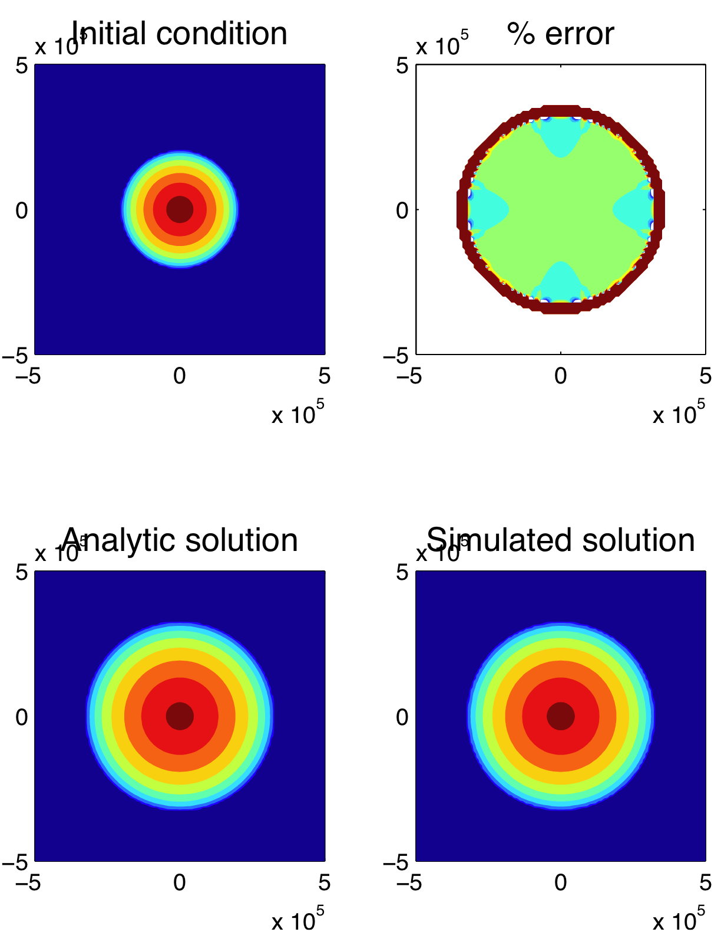
Scheme testing
Halfar solution vs. model
Halfar solution:
  Flat bed, zero mass balance,
  no calving
  Radially symmetric shape

Slide 5
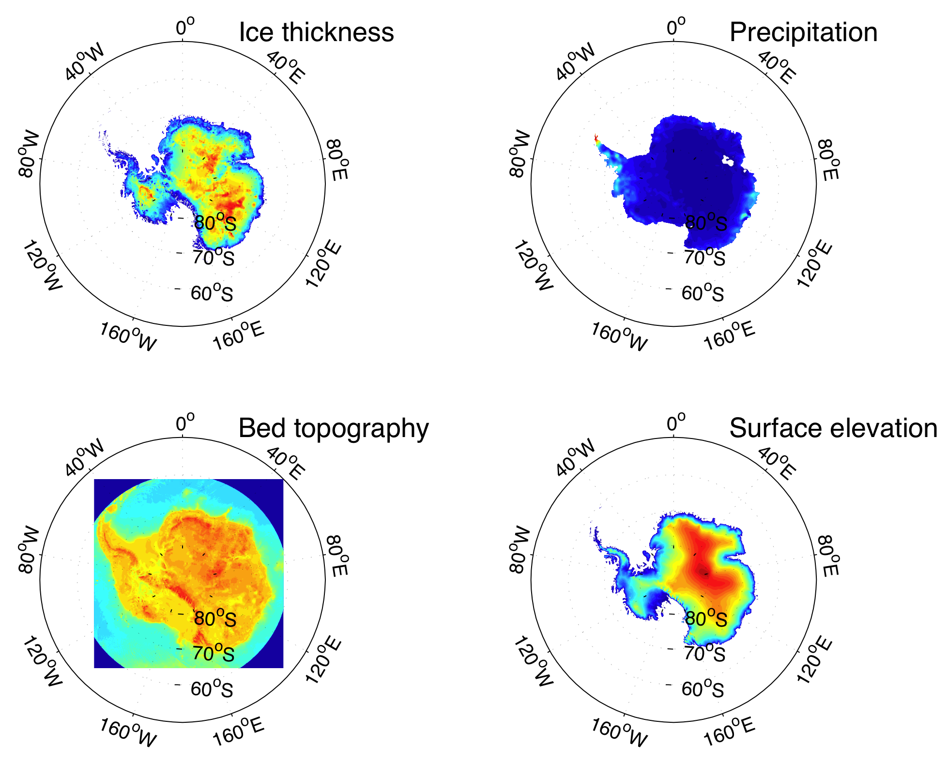
Data
Present day input data for Antarctica:
  Ice thickness
  Bed topography
  Precipitation
  http://websrv.cs.umt.edu/isis/index.phpPresent_Day_Antarctica (SeaRISE)

Slide 6
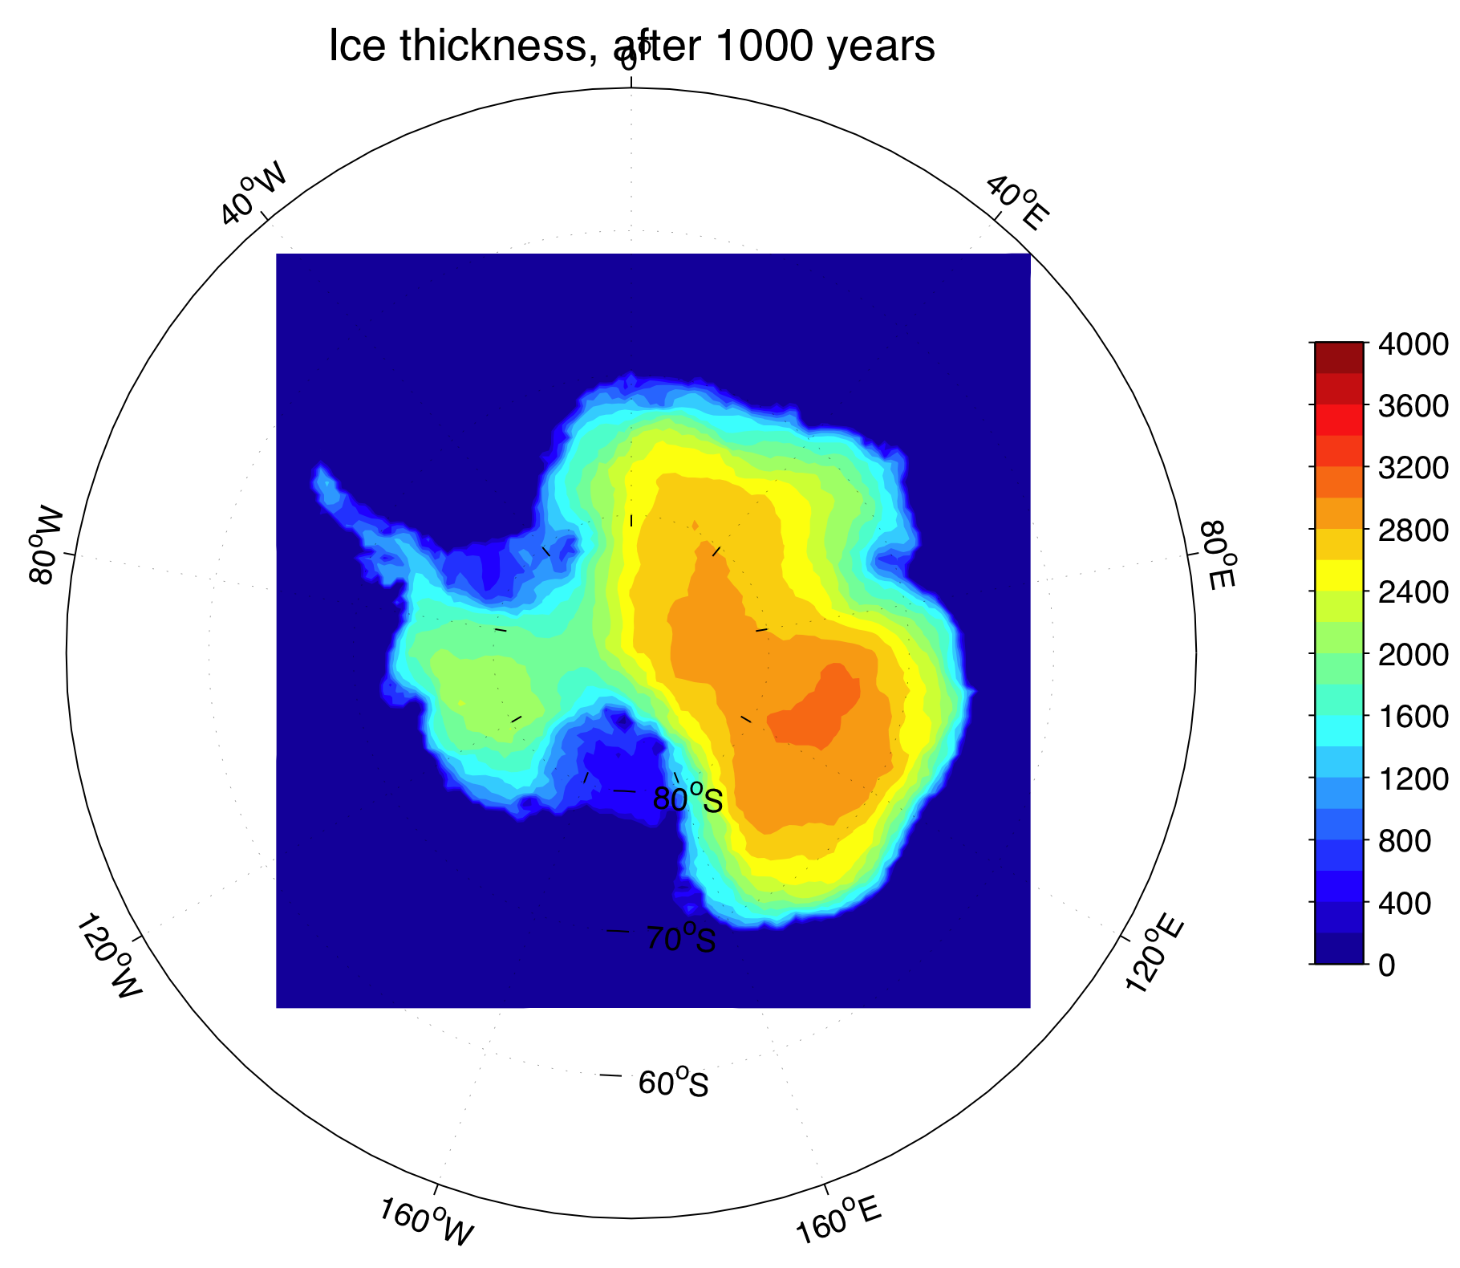
Model results
Antarctic experiment
1000-yr simulation
Mass is conserved
to within 500 m³

Slide 7
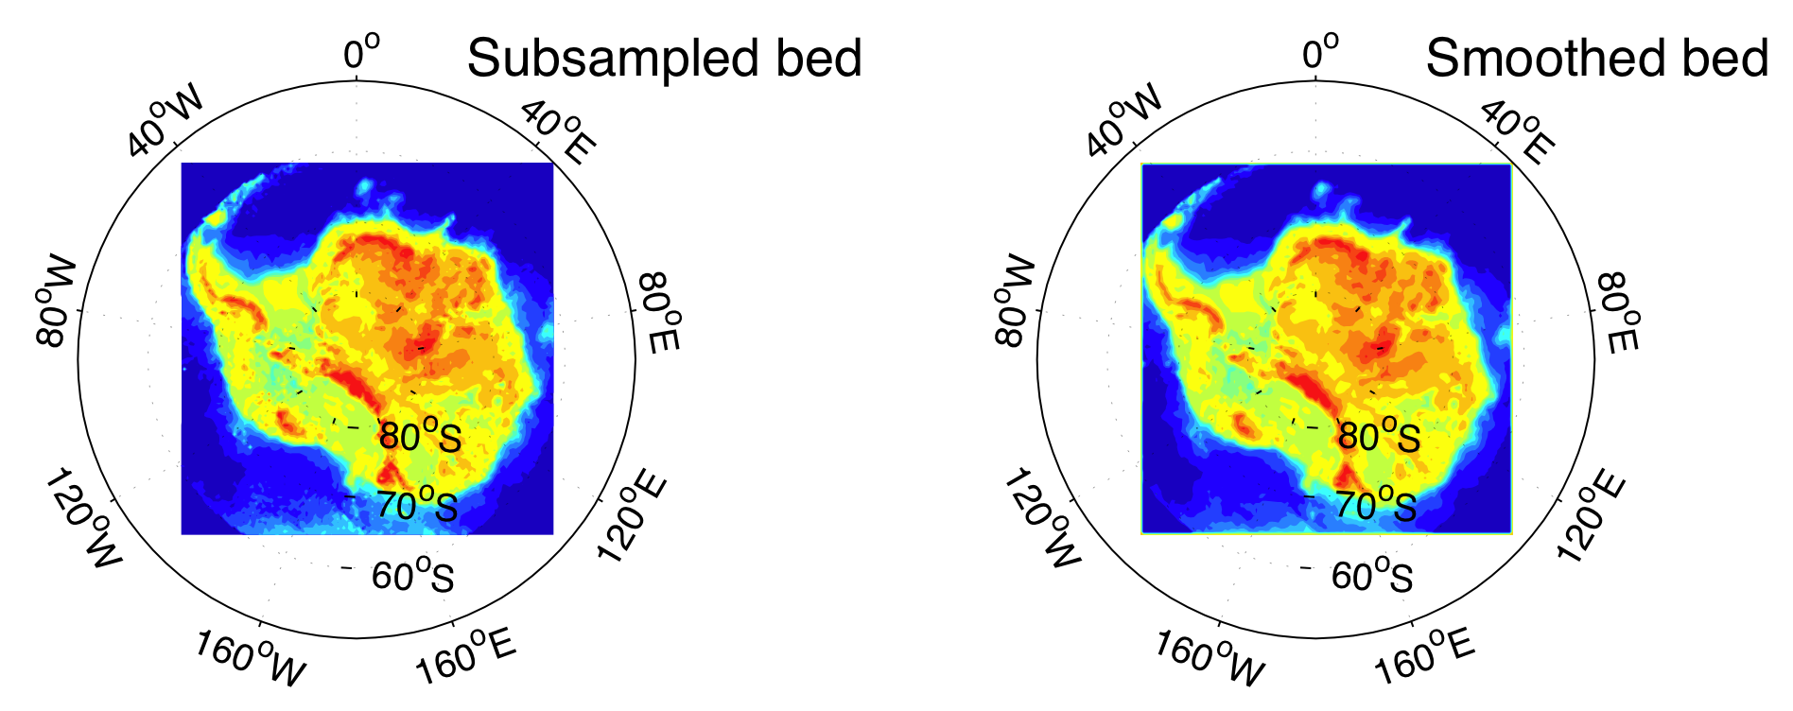
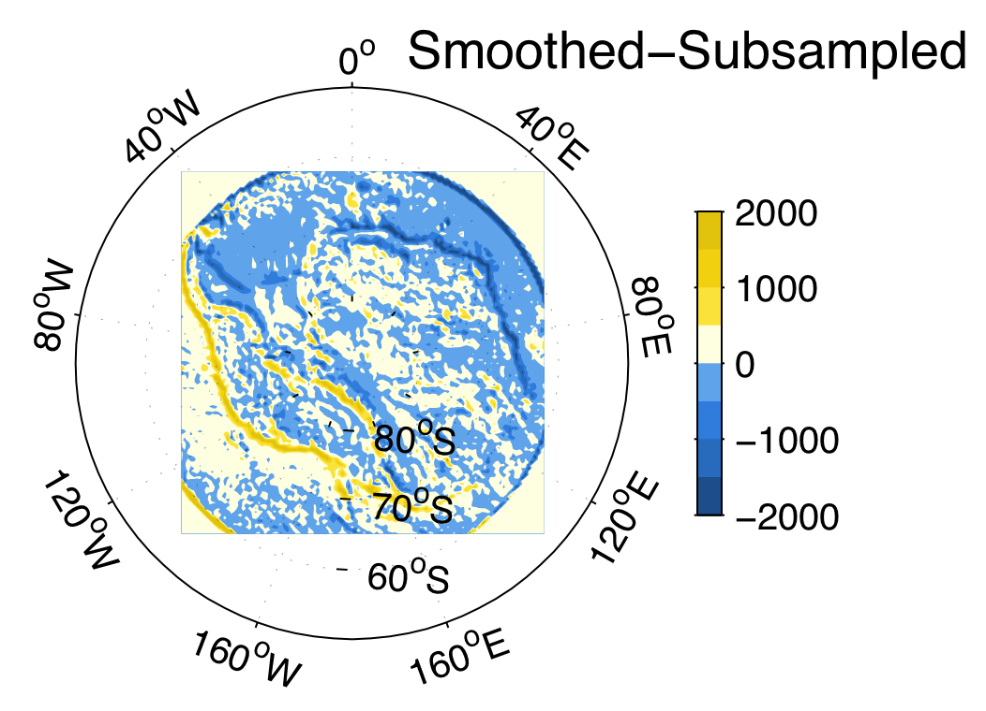
Model results
Smoothing the input data
Adjusted sampling of input data to remove some artifacts

Slide 8
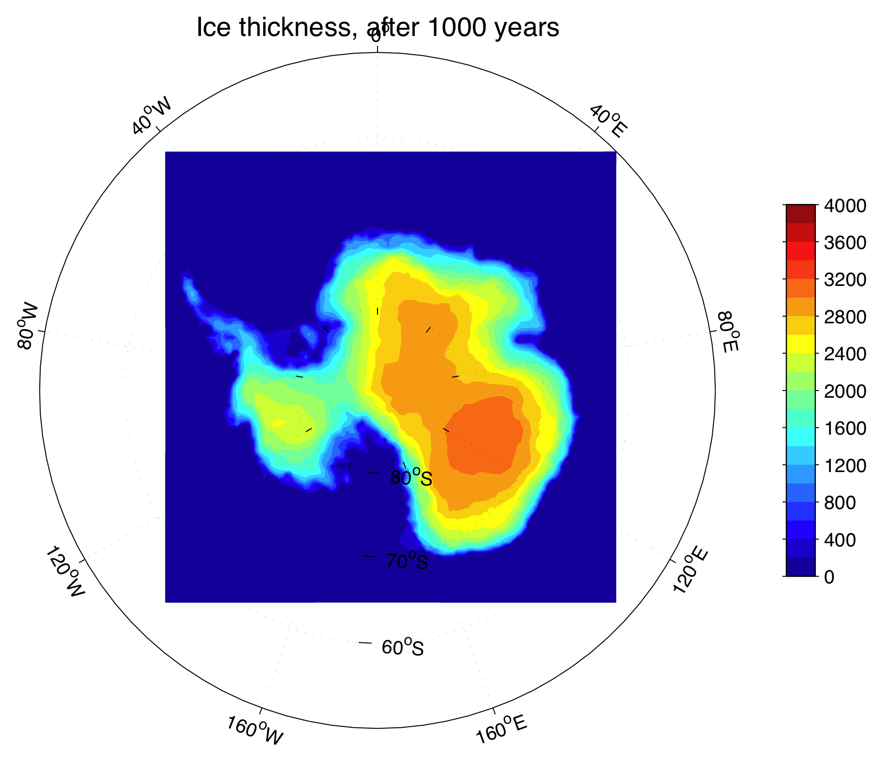
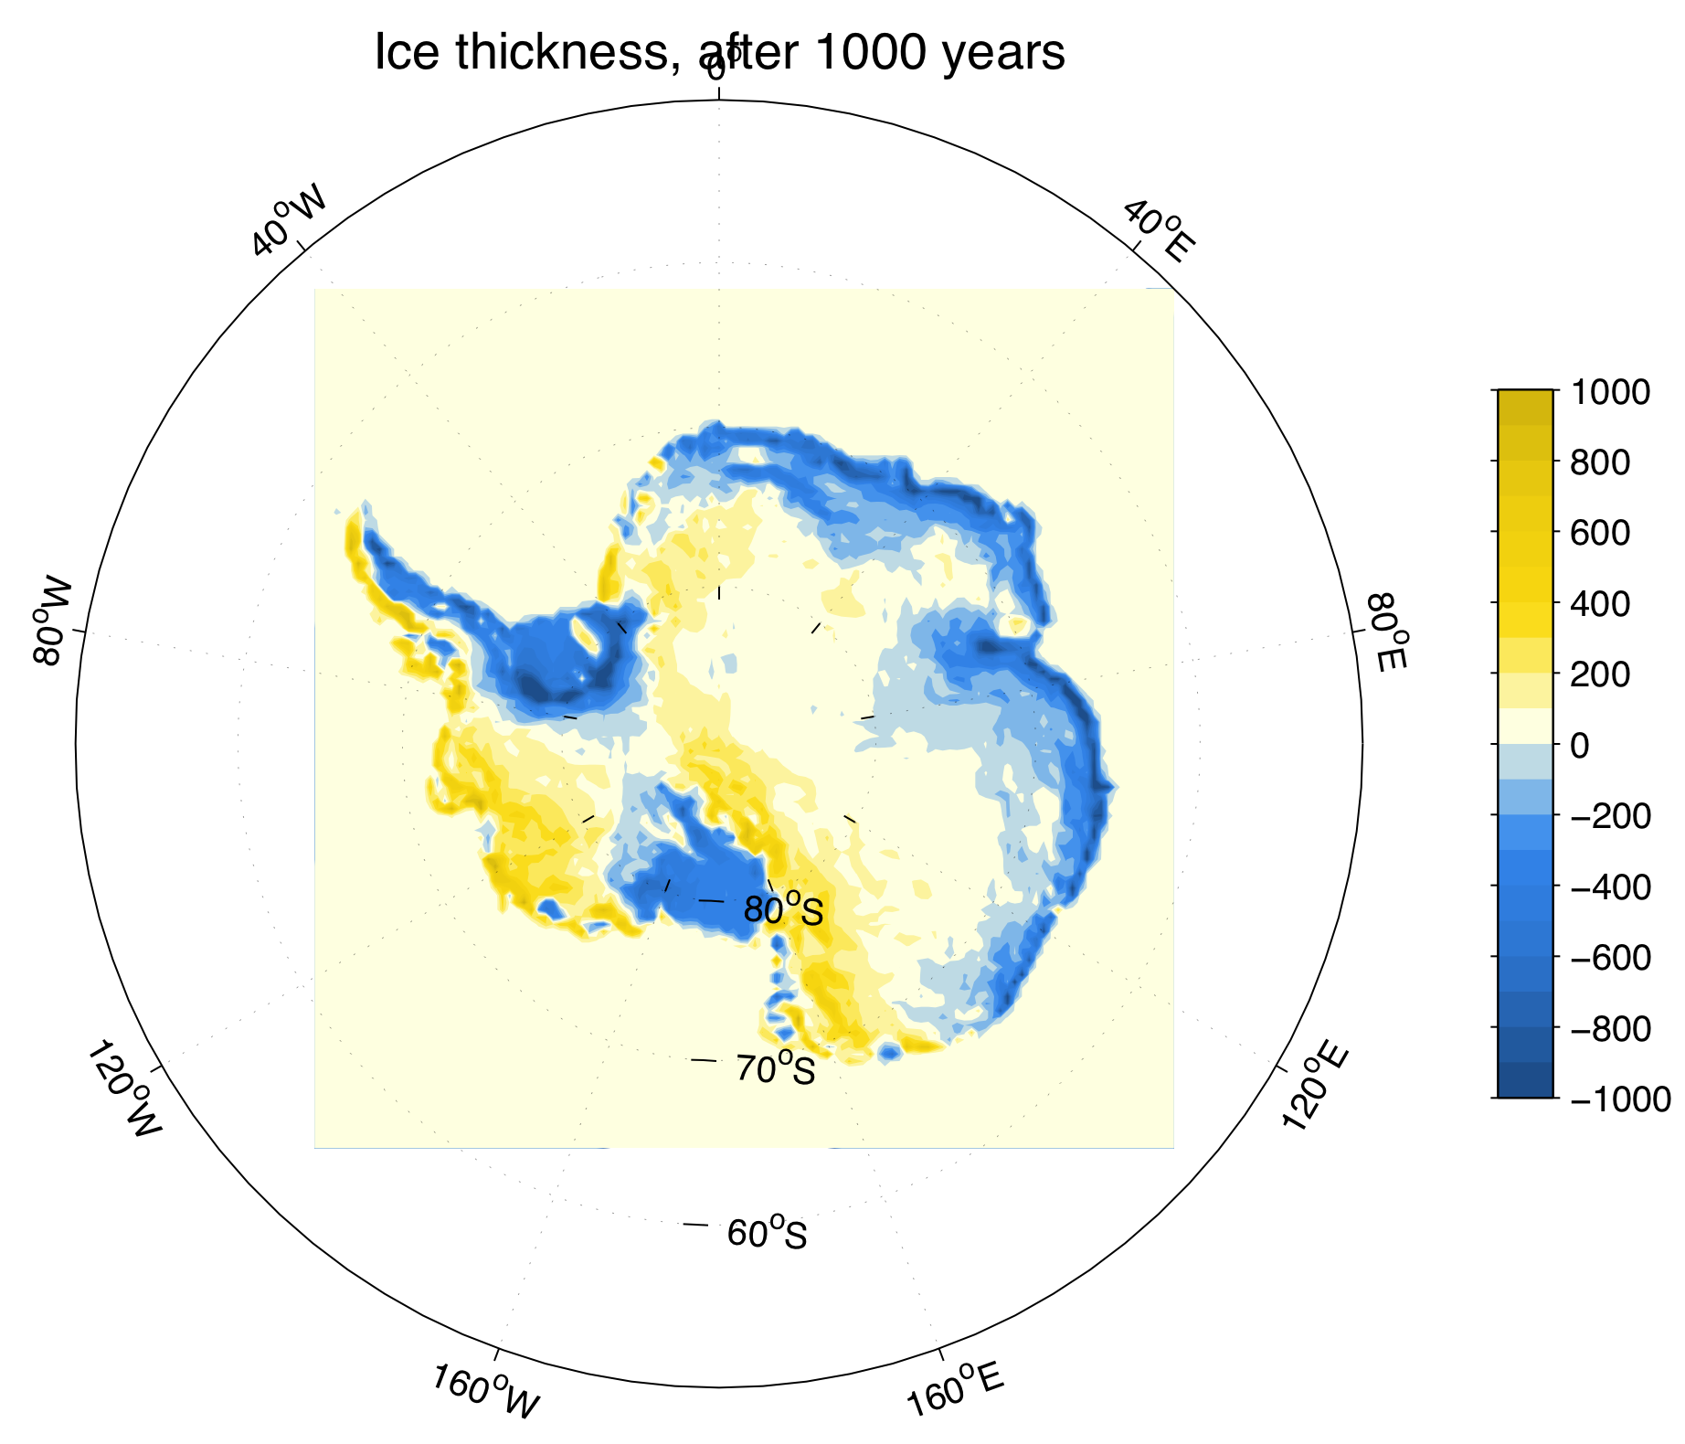
Model results
Smoothing the input data
Sub-sampled
Smoothed
Difference

Slide 9

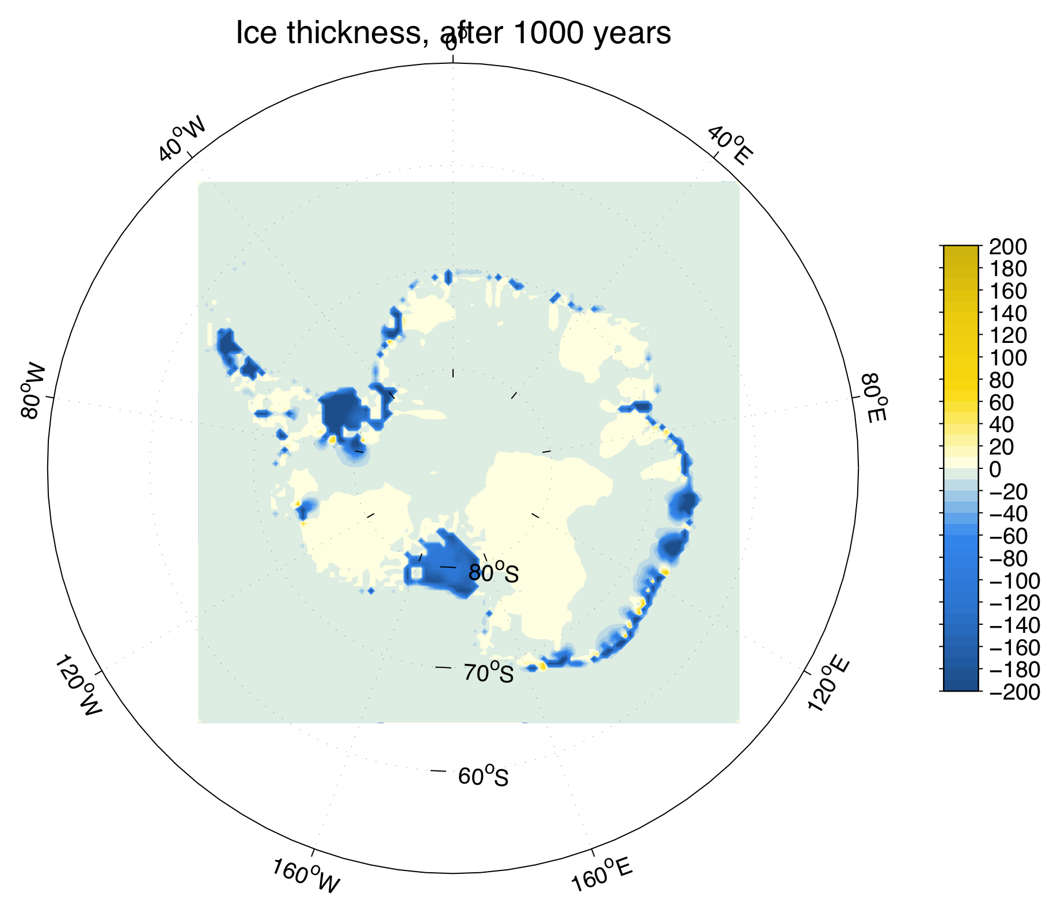
Model results
Implement calving
Add calving
  Criterion 1:
  Criterion 2: No calving within initial grounding line

Slide 10
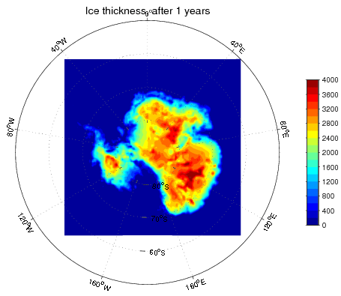
Model results
Implement calving

Slide 11
Discussion
The SIA is a good description of shallow ice sheet evolution given improved mass balance data
Shortcomings:
  No ice shelf formation
  No sliding
  No ice streams
  (To list a few!)

