Slide 1
Ice shelf / ocean interaction modelling
Asbjørn & Aimée
Supervisor: Adrian
Outline
Model setup
Basic exercises
Modelling a real ice shelf

Slide 2
Conceptual picture
Notes:
Plume:
Melting at grounding line is buoyancy source (water freshens)
Water rises turbulently along ice shelf and entrains ambient ocean water → plume grows as it rises
Melts as long as T is above pressure melting point, freezes as soon a T gets below PMP
Freezing decreases buoyancy and slows the plume down

Slide 3
The model
Notes:
2-layered model: ambient ocean and plume
4 ODE’s: mass (change with entrainment and melt), momentum (buoyancy and frictional drag), heat and salt (change as water is entrained and ice is melted).
Delta rho=equation of state
Parameterization of entrainment (linearr to velocity and slope)
3 BC’s: diffusion of heat and salinity, pressure melting point

Slide 4
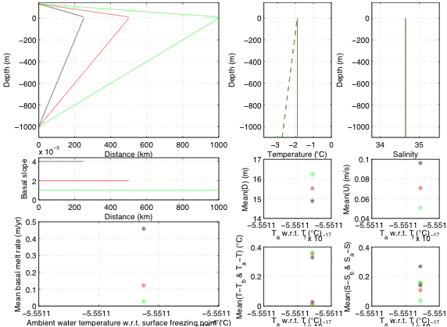
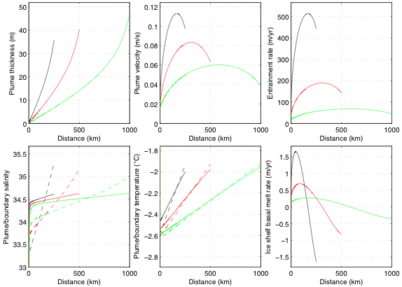
Basics: steep/flat bed
Notes:
Steep: affects eq momentum and entrainment.
Momentum: entrainment -> more heat -> more melt -> buoyancy.
Dotted=ice-plume boundary
Solid = plume

Slide 5
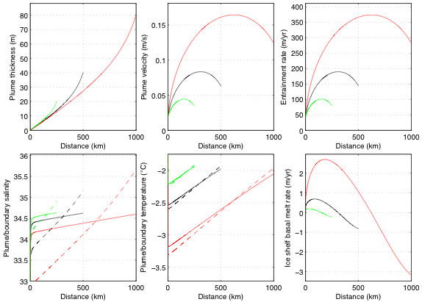
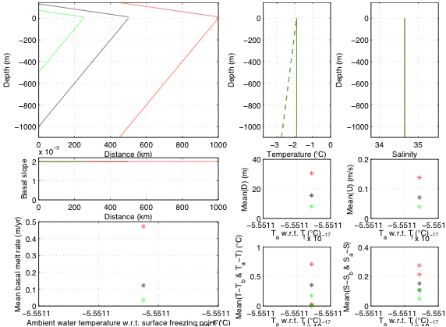
Basics: deep/shallow bed
Notes:
Steep: very warm compared to pressure

Slide 6
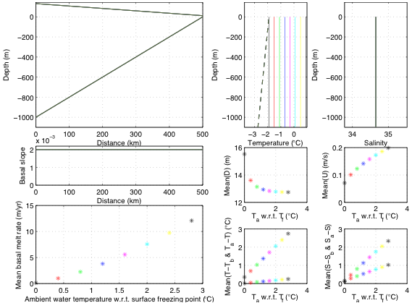
Basics: changing ambient water temperature
Notes:
1. Explain experiment
2. Formula
3. Left term=0 => balance of buoyancy and turbulent drag
4. D is constant, see from bottom middle fig
5. Since drho goes as T we get u2 as T
6. Show in figure right middle
7. Entrainment linear with u

Slide 7
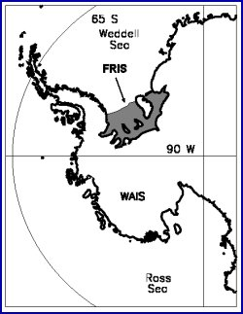
Filchner Ronne Ice Shelf - West

Slide 8
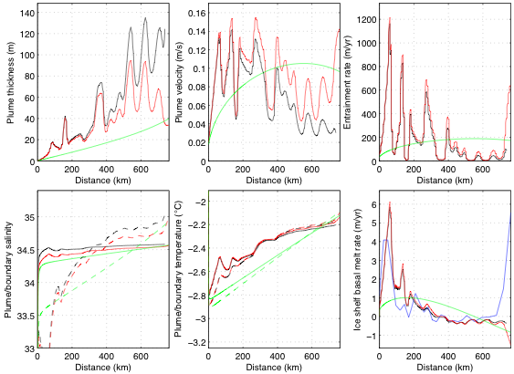
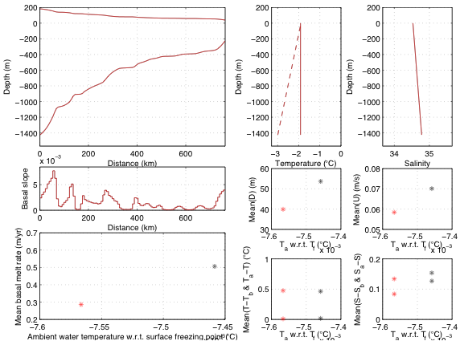
Modelling: FRIS
Notes:
Green=linear base, unstrat
Red=actual base with unstrat T and S
Black = actual base with actual T and S
Blue = observed melt rate

Slide 9
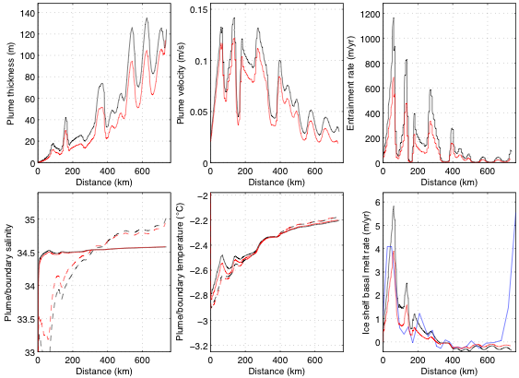
FRIS: tune for E₀

Slide 10
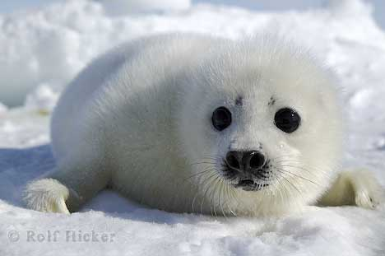
Questions??

